Slide 1

VLSI : VERY LARGE SCALE INTEGRATION
Course Instructor : Mrs. Vaishnavi

Slide 2

DIGITAL LOGIC DESIGN
Simulation Based Project
ROOM SECURITY AND AUTOMATION SYSTEM
Presented By: Pushap Mohan Sharma
B.Tech-Ist Year, Micro-Electronics and VLSI
Roll No: 124113008

Slide 3
Scenario:
There's "Digital Lock" on the door of the room. To enter the room someone must enter 5 digit pin. The lock takes only binary numbers as pin. If 5 digit pin is correctly given then the door is unlocked.
Inside the room there's a "Motion detector". If the motion detector detects any movement then "Light bulb" will turn on and also checks room temperature. If room temperature is high then "Air Condition" is also turned on.
Now, if someone gives incorrect pin the system will show wrong Pin. After giving incorrect pin 3 times in a row the system will notify the owner and "Alarm" will go off. But if correct pin is given before 3 tries the counter resets itself.
There's another security option. If the door lock is unchecked but there's movement inside the room, the alarm will go off and notify owner.

Slide 4
Problem breakdown:
Step 1: Making a password/ pin checking system that checks 5 digits inputs.
Step 2: Making a Counter that can check number of times wrong pin is given.
Step 3: Making an alarm that goes off if n number of times wrong pin is given or there's unexpected movement.
Step 4: Making Light bulb and AC that can be turned on conditionally.
Step 5: Combining all the above mentioned small systems together.

Slide 5
Solution:
Step 1: We need something that can check if all the inputs are same. XNOR gate
Step 2: We can make Counter using JK flip-flop.
Step 3: Alarm system can be made using few logic gates.
Step 4: Light bulb and AC can turned on with logic gates.

Slide 6
Components:
XNOR_2 5
AND_5 1
AND_2 6
NOT 4
JK_FF 2
Prob_Light 5
DCD_HEX 1
Software Used :
NI Multisim

Slide 7
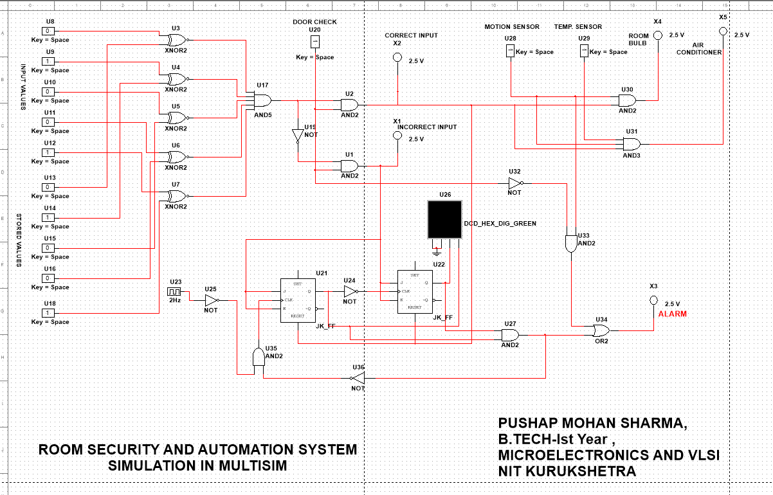
Design in Multisim

Slide 8
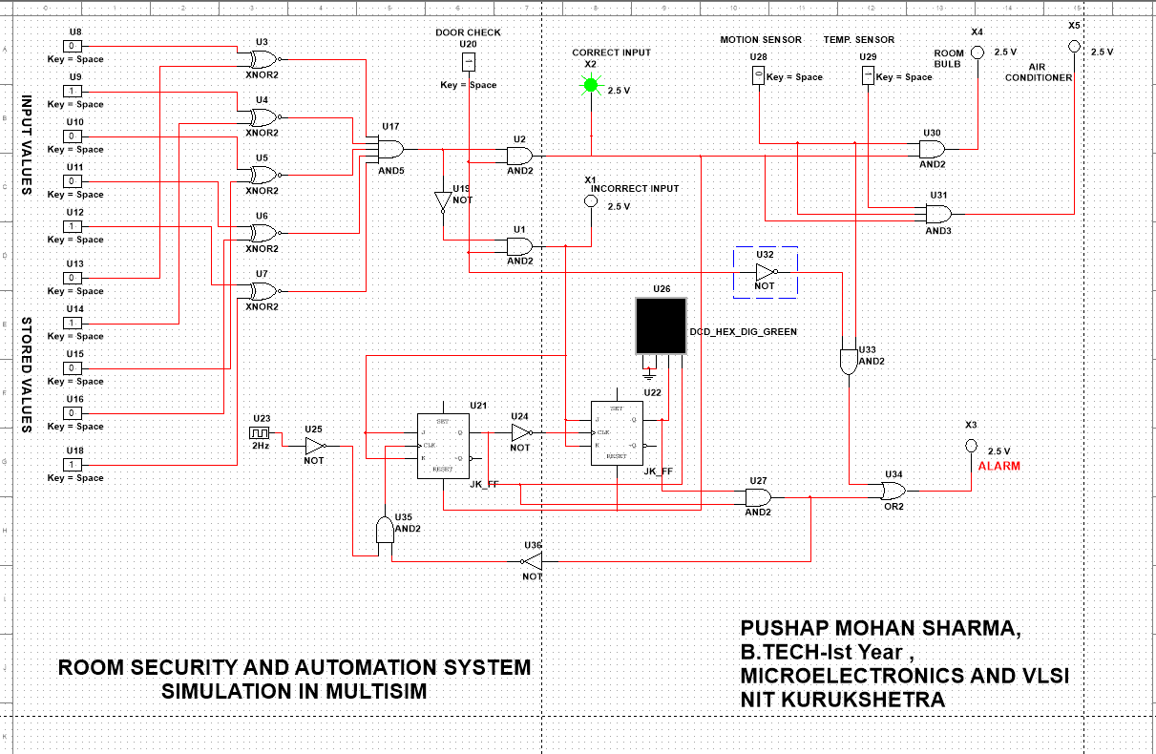
Case 1- When PIN entered Matches the Stored Pin

Slide 9
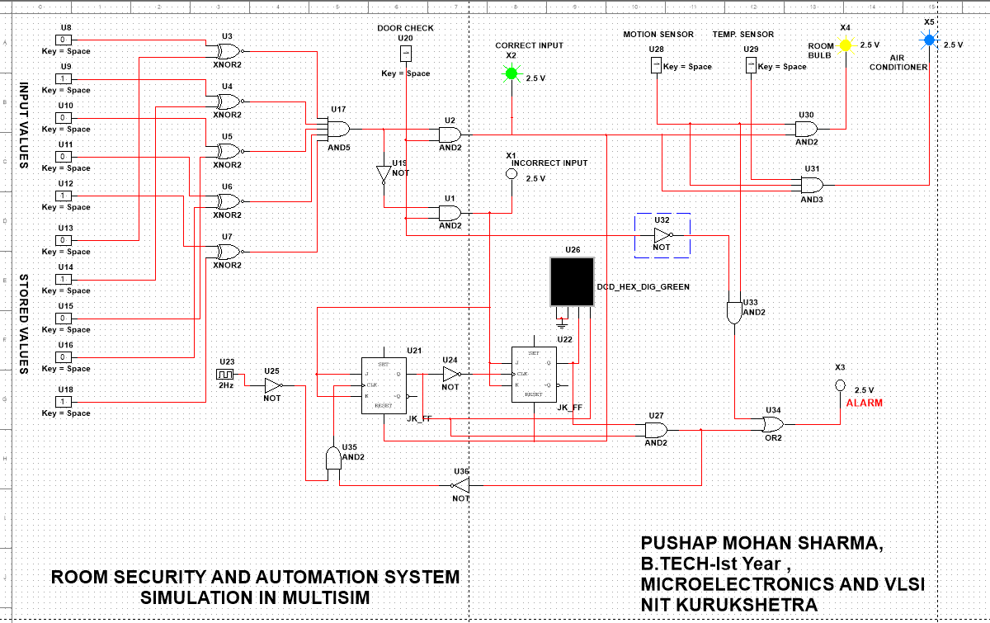
Case 2- When PIN Entered Correct and Motion in Room and Room Temp is High

Slide 10
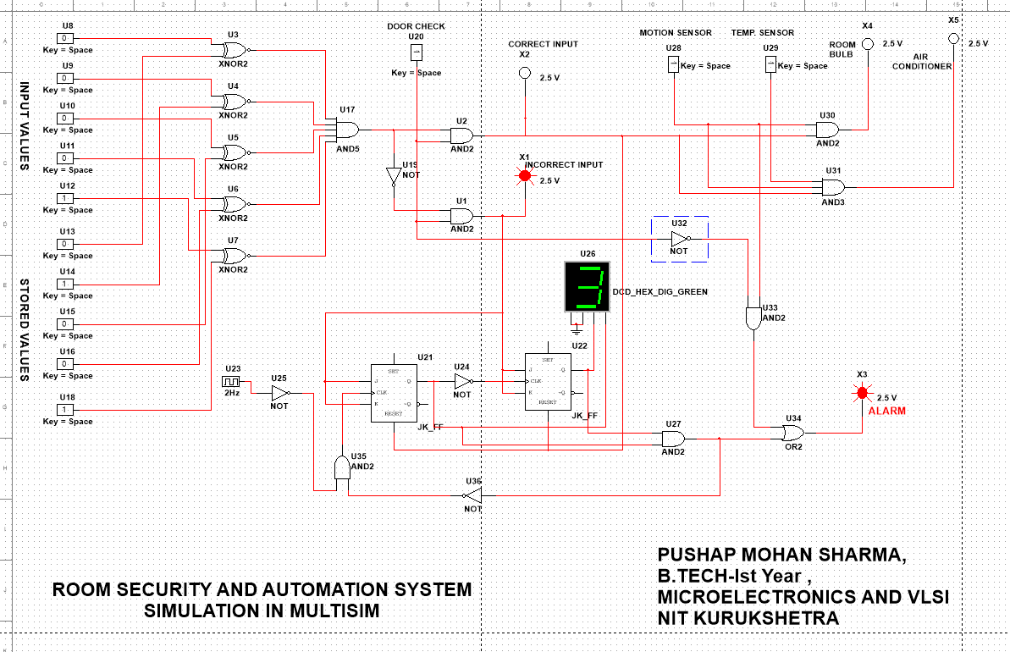
Case 3- When PIN Entered In-correct in Three Attempts Alarm Generate

Slide 11
THANKS

